Slide 1

THE ULTRASWITCH - a remoteqth project by DM5XX -

Slide 2
remoteQTH.com
OPEN-SOURCE Hardware + OPEN-SOURCE Firmware
OK1HRA, Dan | OK2ZAW, Jan | OK1CDJ, Ondra | DM5XX, Mike
https://remoteqth.com + qro.cz + hamshop.cz = OL7M
K9AY
Beverages: Top band, single band, bi-directional 2-wire, 4-way bi-directional,…
Switching: 6To2/6To1/4To1, 6To2+Triplexer, 1To2/1To3 Stackmatch, 12x4,…
Variable ATT, SO2R, M/M, Controller (on-site/remote), Custom Contest Hardware…

Slide 3

DM5XX
Radio amateur seit 1990 (OK8XX, DM5X, ex. DG3NED, ex. DL3NED) living in Nuremberg
Senior Software Engineer
IT-Project Lead @ ADITUS GmbH
Since 2015 Lead Firmware Developer @remoteqth.com
Developer of embedded microcontroller firmware

Slide 4
The Ultraswitch
Wifi based & inspired of mega-webswitch (63-CH remote-switch)
Part of the 256-Port-Inband-Antennenproject @ OL7M
Simple hardware direct from China (ebay.com)
ESP8266-12F („Wemos D1 mini“)
Modular: Up to 8 Boards
Web-UI & Web-Config
RESTful and simple extendable thanks to ist web based architecture

Slide 5
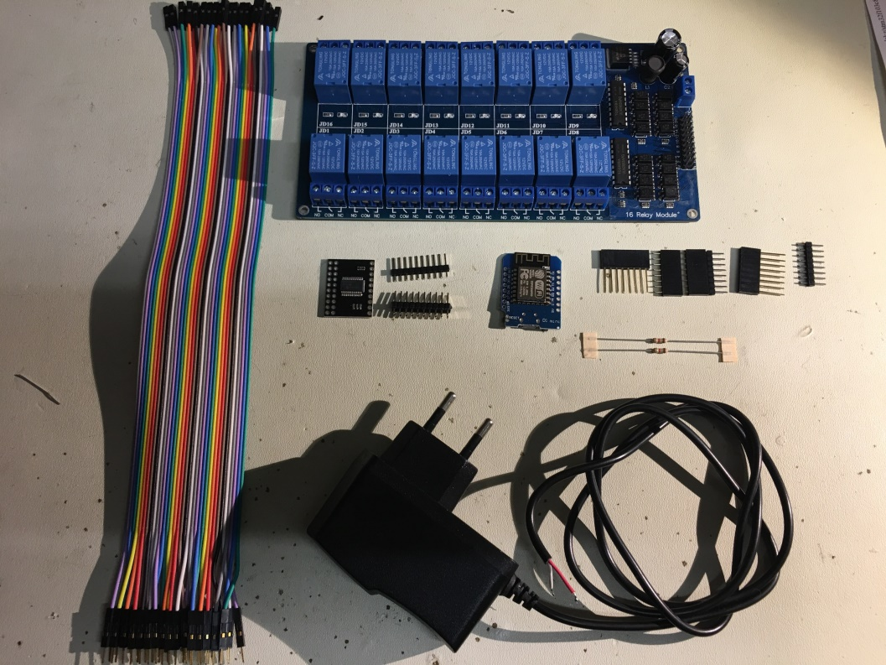
Needed Hardware
16-CH 12V-Relayboard
MCP23017SMD on a PCB (I2C=>16 Port)
Wemos D1 mini (ESP8266-12F, Controller)
2x 1.8K/2.2K
DuPont connector
12V-Power supply
Computer+MicroUsb-Cable

Slide 6


The architecture
Separation of Concerns:
Hardware layer (1)
Hardware based functionality (JSON) (1)
Function layer (JS) (2)
Presentation layer (UI) (3)
=> aka 3-Layer-Model
Browser: (3) UI
Javascript: (2) Control
(1) ESP12F/RelayBoard

Slide 7
Pros and Cons
Pro:
Simple extendable, not dependend on the UI (Web-App, Windows-App, Mobile-App, Linux-App,…)
Seperation of hardware, logic and (business) functions
Centralized, modular, web technology, ready for future demands
Add your own functions and/or UI (Customizing)
Cons:
Security concerns are up to you
The more you are customizing, the more you need to know (learning curve)

Slide 8

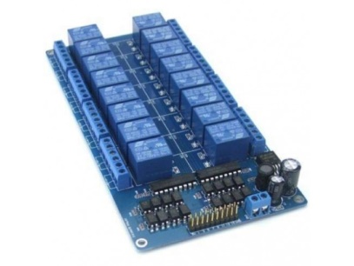
Usecase 1 – „Out of the box“
No changes to be made
All already available resources („h.mmmedia-online.de“) are used.
Just the configuration of the switch is necessary (IP-Adress)
Software is always up-to-Date
Cons: You cannot change something – including the labels.
HTTP-Response
Own Browser
Ultraswitch:
Index.html
HTTP-Request
h.mmmedia-online.de
Javascript:
ultraswitch_v1.js,
ultraswitch_content_v1.js
CSS:
Ultraswitch_v1.css

Slide 9
Usecase 2 – Using ur own „Desktop-Application“
Easy to custimize
All resources are local on ur PC
Everything customizable
No own webserver is needed
Cons: No updates out of the box, no longer multi-user capable (Logic/Infos are on ur own pc). Not mobile accessable.
HTTP-Response
PC:
Index.html
Own Browser
Javascript:
ultraswitch_v1.js,
ultraswitch_content_v1.js
CSS:
Ultraswitch_v1.css
HTTP-Request

Slide 10
Usecase 3 – „Own Webserver“
All advantages of Case 1 and 2
Multi user capability
Server could be in your own network
Cons:
Webspace needed
Knowledge in web techniques needed
Updates no longer out of the box
HTTP-Antwort
Eigener Browser
Ultraswitch:
Index.html
HTTP-Schaltbefehl
www.eigenerserver.de 192.168.1.1
Javascript:
ultraswitch_v1.js,
ultraswitch_content_v1.js
CSS:
Ultraswitch_v1.css

Slide 11

Good to know
Computer networks
Network protocols
JSON
HTML, CSS, Javascript
Introduction into REST

Slide 12
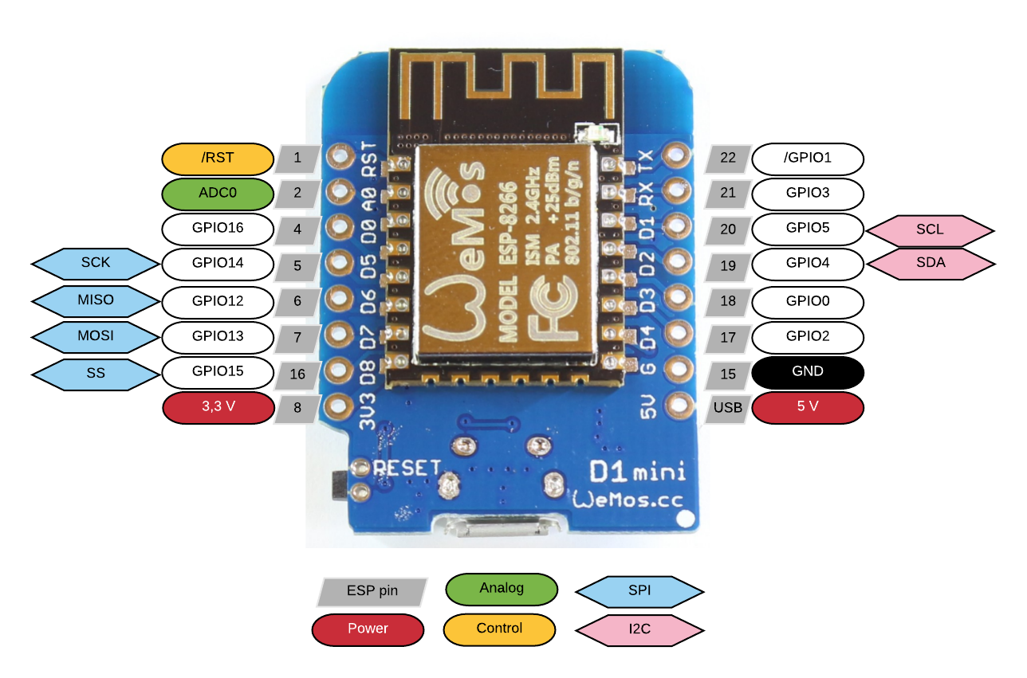
Hardwareplattform – ESP8266-12F
802.11 b/g/n, Wi-Fi 2.4 GHz, support WPA/WPA2
Integrated low power 32-bit MCU @80mhz,4MB Ram, 92kb
Integrated 10bit ADC
Integrated TCP/IP protocol stack
Integrated TR switch, balun, LNA,
power amplifier and matching network
Integrated PLL, regulators, and power management units
Supports antenna diversity
Support STA/AP/STA+AP operation modes
Support Smart Link Function for both Android and iOS devices
SDIO 2.0, (H) SPI, UART, I2C, I2S, IRDA, PWM, GPIO, STBC, 1x1 MIMO, 2x1 MIMO
Deep sleep power <10uA, Power down leakage current < 5uA
Standby power consumption of < 1.0mW
http://stefanfrings.de/esp8266/
Datasheet

Slide 13
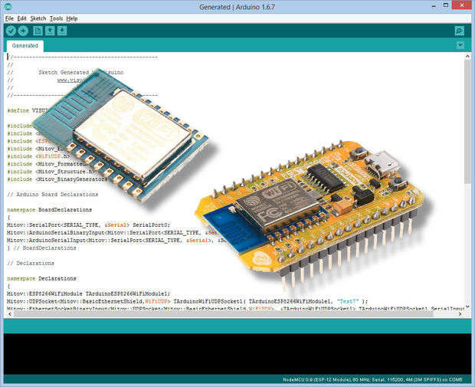
Arduino-IDE
Installing Arduino IDE
https://learn.sparkfun.com/tutorials/esp8266-thing-hookup-guide/installing-the-esp8266-arduino-addon
http://arduino.esp8266.com/versions/2.3.0/package_esp8266com_index.json (Use 2.3.0! 2.4.0 has a bug)

Slide 14
Libraries
Installing Additional Arduino Libraries (content of needed_libraries is copied to your arduino library folder)
After IDE-Installation look for your project files…
C:\Users\mmmedia\Documents\Arduino => copy the folder „Ultraswitch“ into this folder
C:\Users\mmmedia\Documents\Arduino\libraries => Content of “Ultraswitch/needed_libraries“ are copied to this location
Copy to your desktop: (for later use) => Folder “ultraSwitch_web”

Slide 15
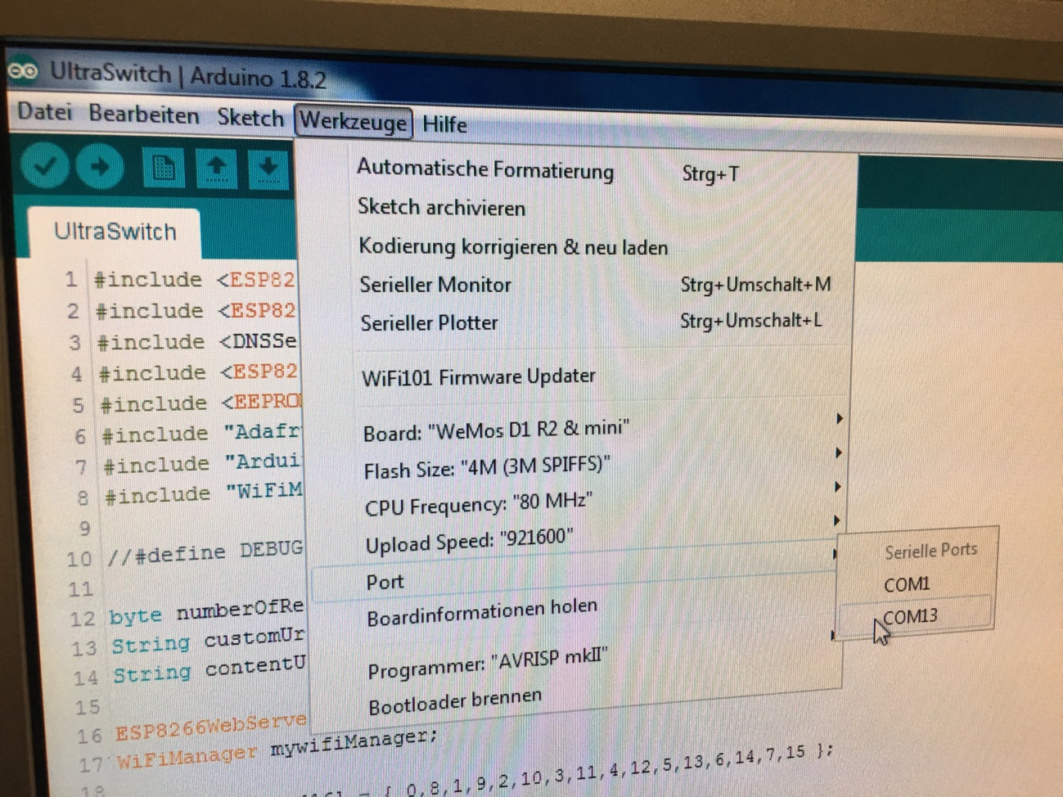
Lets go: 8266-12F
Board ESP added?
Libraries copied?
Sketch loaded? (ultraswitch.ino)
Preferences adjusted?
Serial port connected?
12F connected to usb?
Yes? => Verify > Upload!
engl.: „Tools“

Slide 16
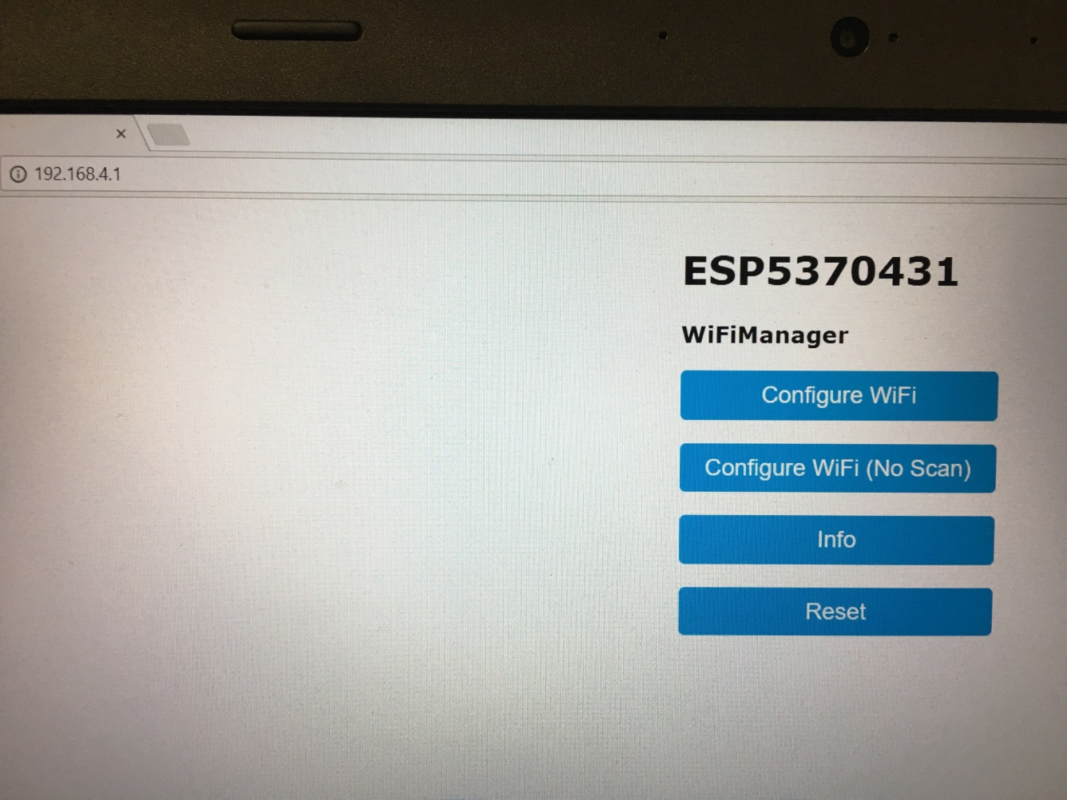
Connecting to the 12F – AP-Mode 1
Search for the Wifi-Network ESP<number> (with ur smartphone)
Connect to ESP<number>
Open your Browser (Default: 192.168.4.1) – do nothing more yet!

Slide 17
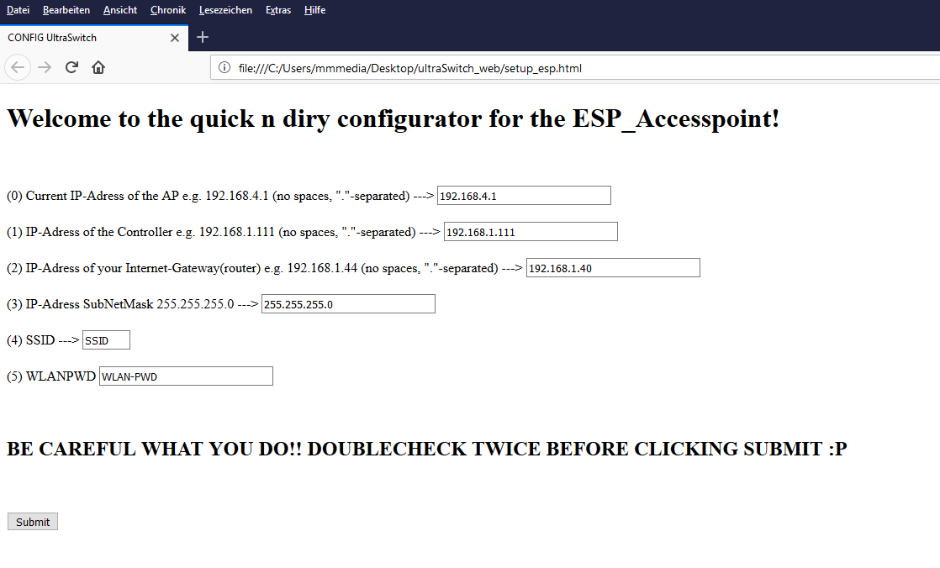
Connecting to the 12F – AP-Mode 2
Execute setup_esp.html in the folder „Ultraswitch_Web“ with a double click.
Change ur data – give everithing its needed ip, mask, ssid, wifi-pwd
Submit!

Slide 18
Connecting to the 12F– AP-Mode 3
Change into your normal wifi
Open your 12F-Ip in your browser (z.B. 192.168.1.123)
„Configure Wifi“
192.168.1.123

Slide 19
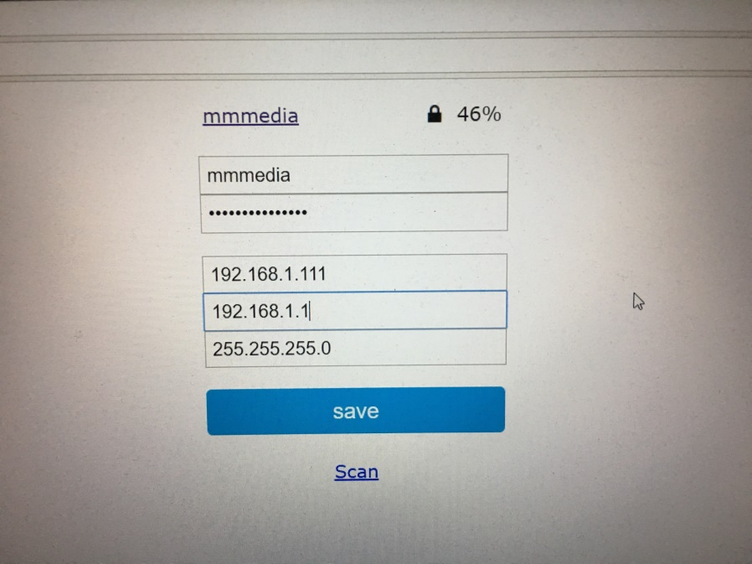
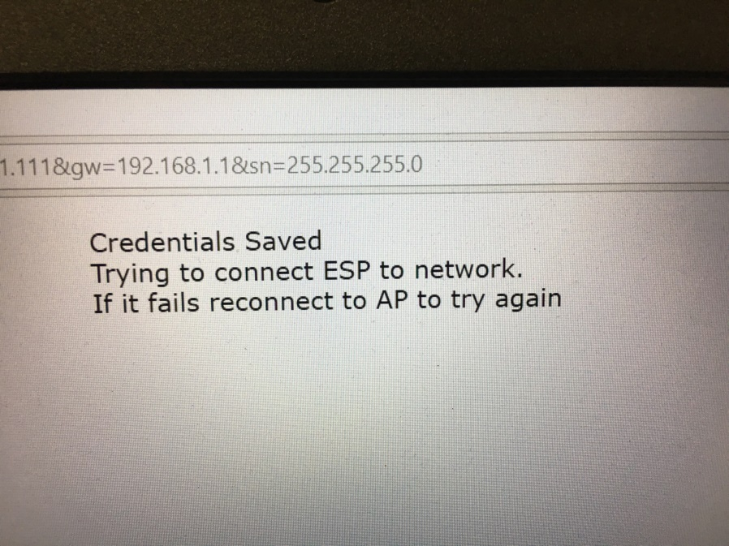
Connecting to the 12F – AP-Mode 4
„Configure Wifi“: Give SSID and Wifi-PWD again!
Double check your data! Save.

Slide 20
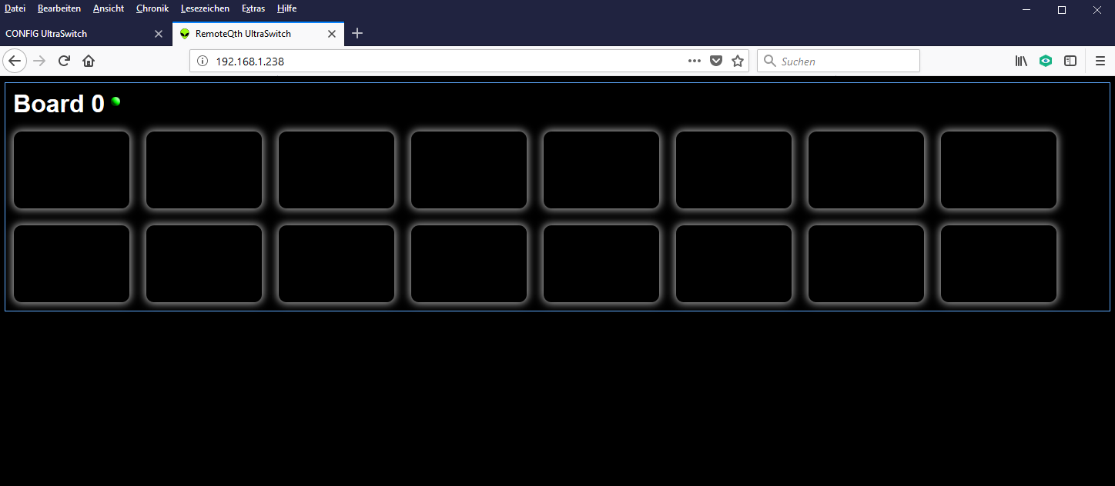
Connecting to the 12F – First contact
Call your Ultraswitch by ist IP.
Troubleshooting: Ultraswitch not found? Advanced IP-Scanner helps! Scan your network!
But you can see no buttons, …

Slide 21
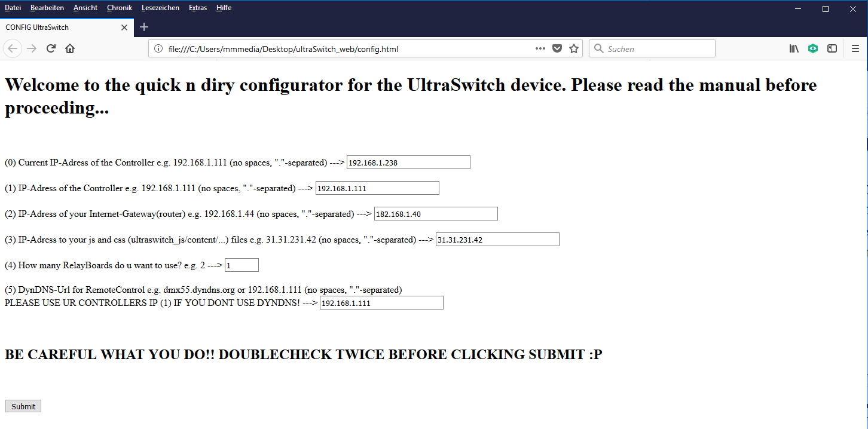
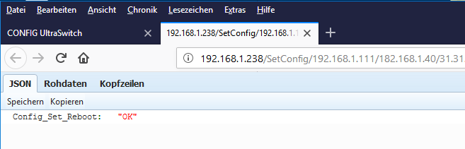
Connecting to the 12F – IP-Settings Servermode
Call Config.html
You need to know the IP of your Ultraswitch now!
You can give the ultraswitch another ip if u want
Add all needed info
Submit!

Slide 22
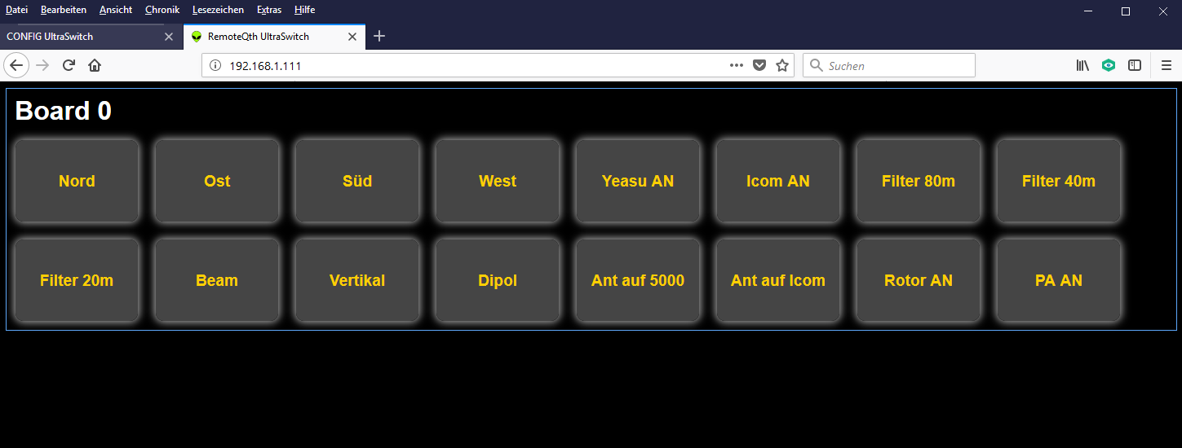
Final IP-Adresse of your Ultraswitch: The UI is working!

Slide 23
Something is wrong in your sketch... DEBUG!
Uncomment ultraswitch.ino: //#define DEBUG to #define DEBUG (remove „//“)
Upload your sketch
Tools => Serial monitor
Adjust Monitor Serial Speed from 9600 to 115200
Reset your Wemos (little switch on your Board)
Serieller Monitor shows your ip and switched pins...
Comment //#define DEBUG after you are done (upload again)

Slide 24
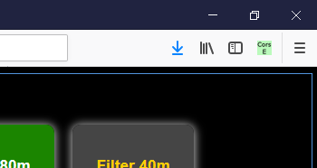
CORS – Cross Origin Request
Due to Ajax-Request i could be, that your browser is blocking those cross origin requests, if you start the index.html from your desktop (file://file:///C:/Users/mmmedia/../../index.html)
Use: CORS Everywhere (Firefox) => Add to your Firefox => Activate CORS E („CorsE“ wird Grün)
Use Firefox!

Slide 25
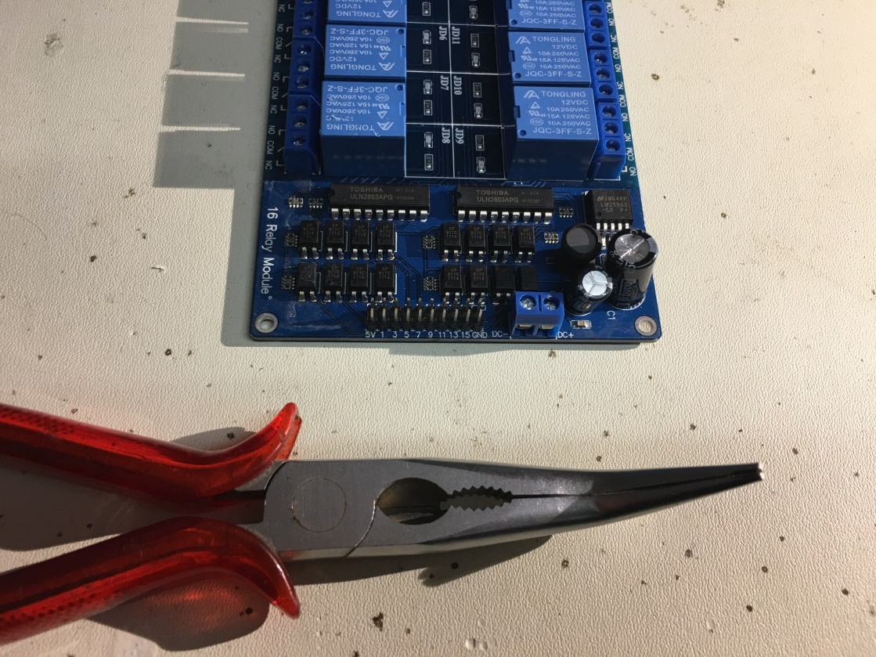
Wiring up your Relaysboard… 1
Use your pliers to bent your header pins of your relay board so they fit into the MCP-Board
2 Pins (3,4) from your MCP-Board need to be unconnected! Its not so easy..

Slide 26
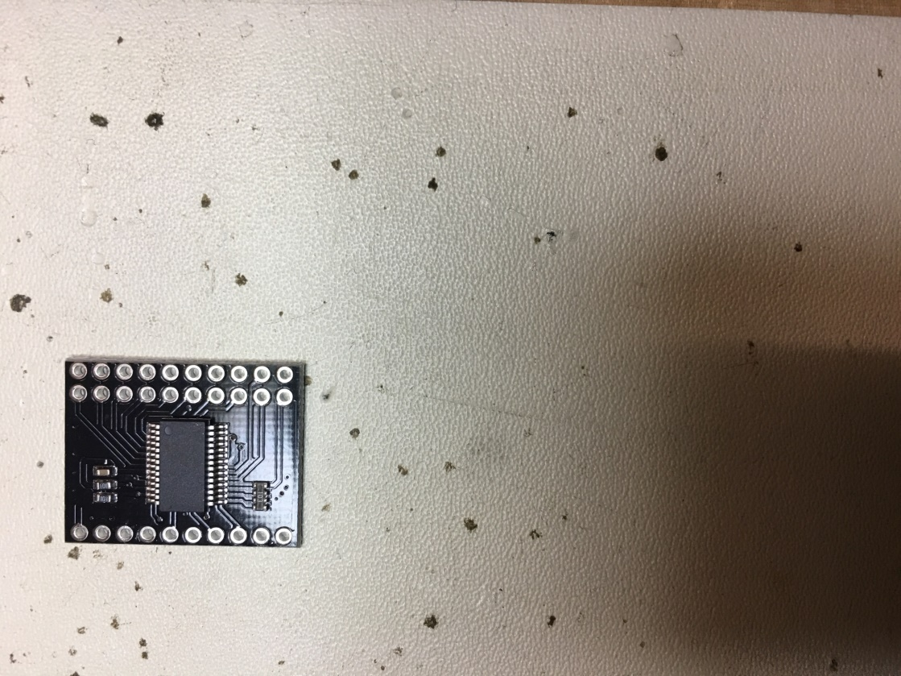
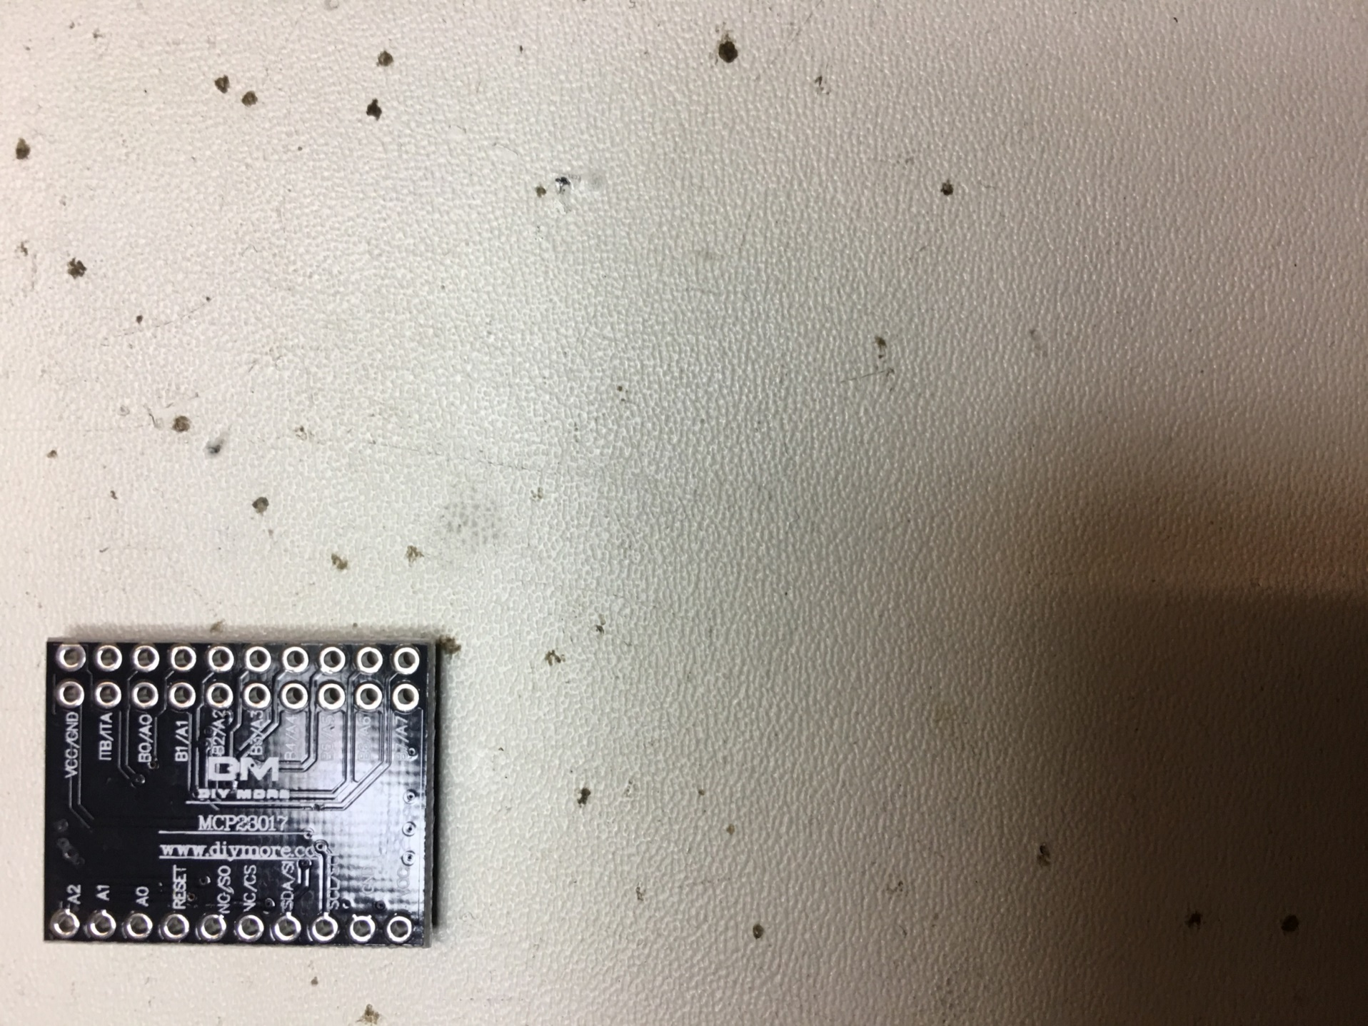
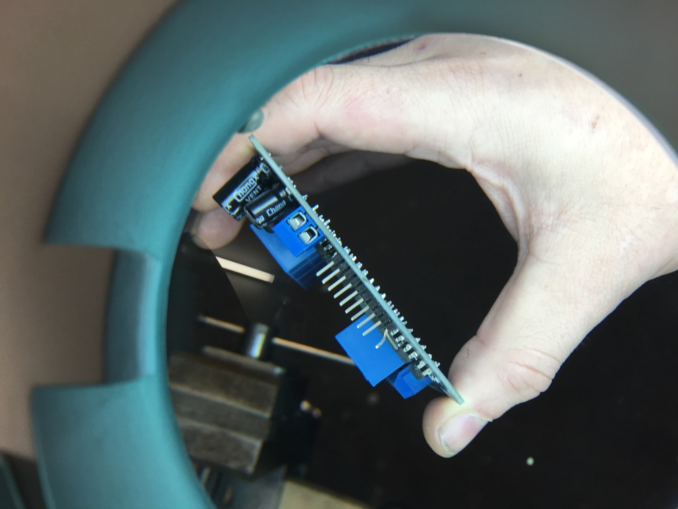
Wiring up your Relaysboard… 2
x
x
x
x

Slide 27
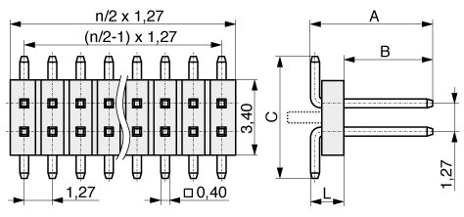
Wiring up your Relaysboard… 3
Pin 1: „Bent“ one grid to the left!
Pin 2: Bent completely!
5V

Slide 28
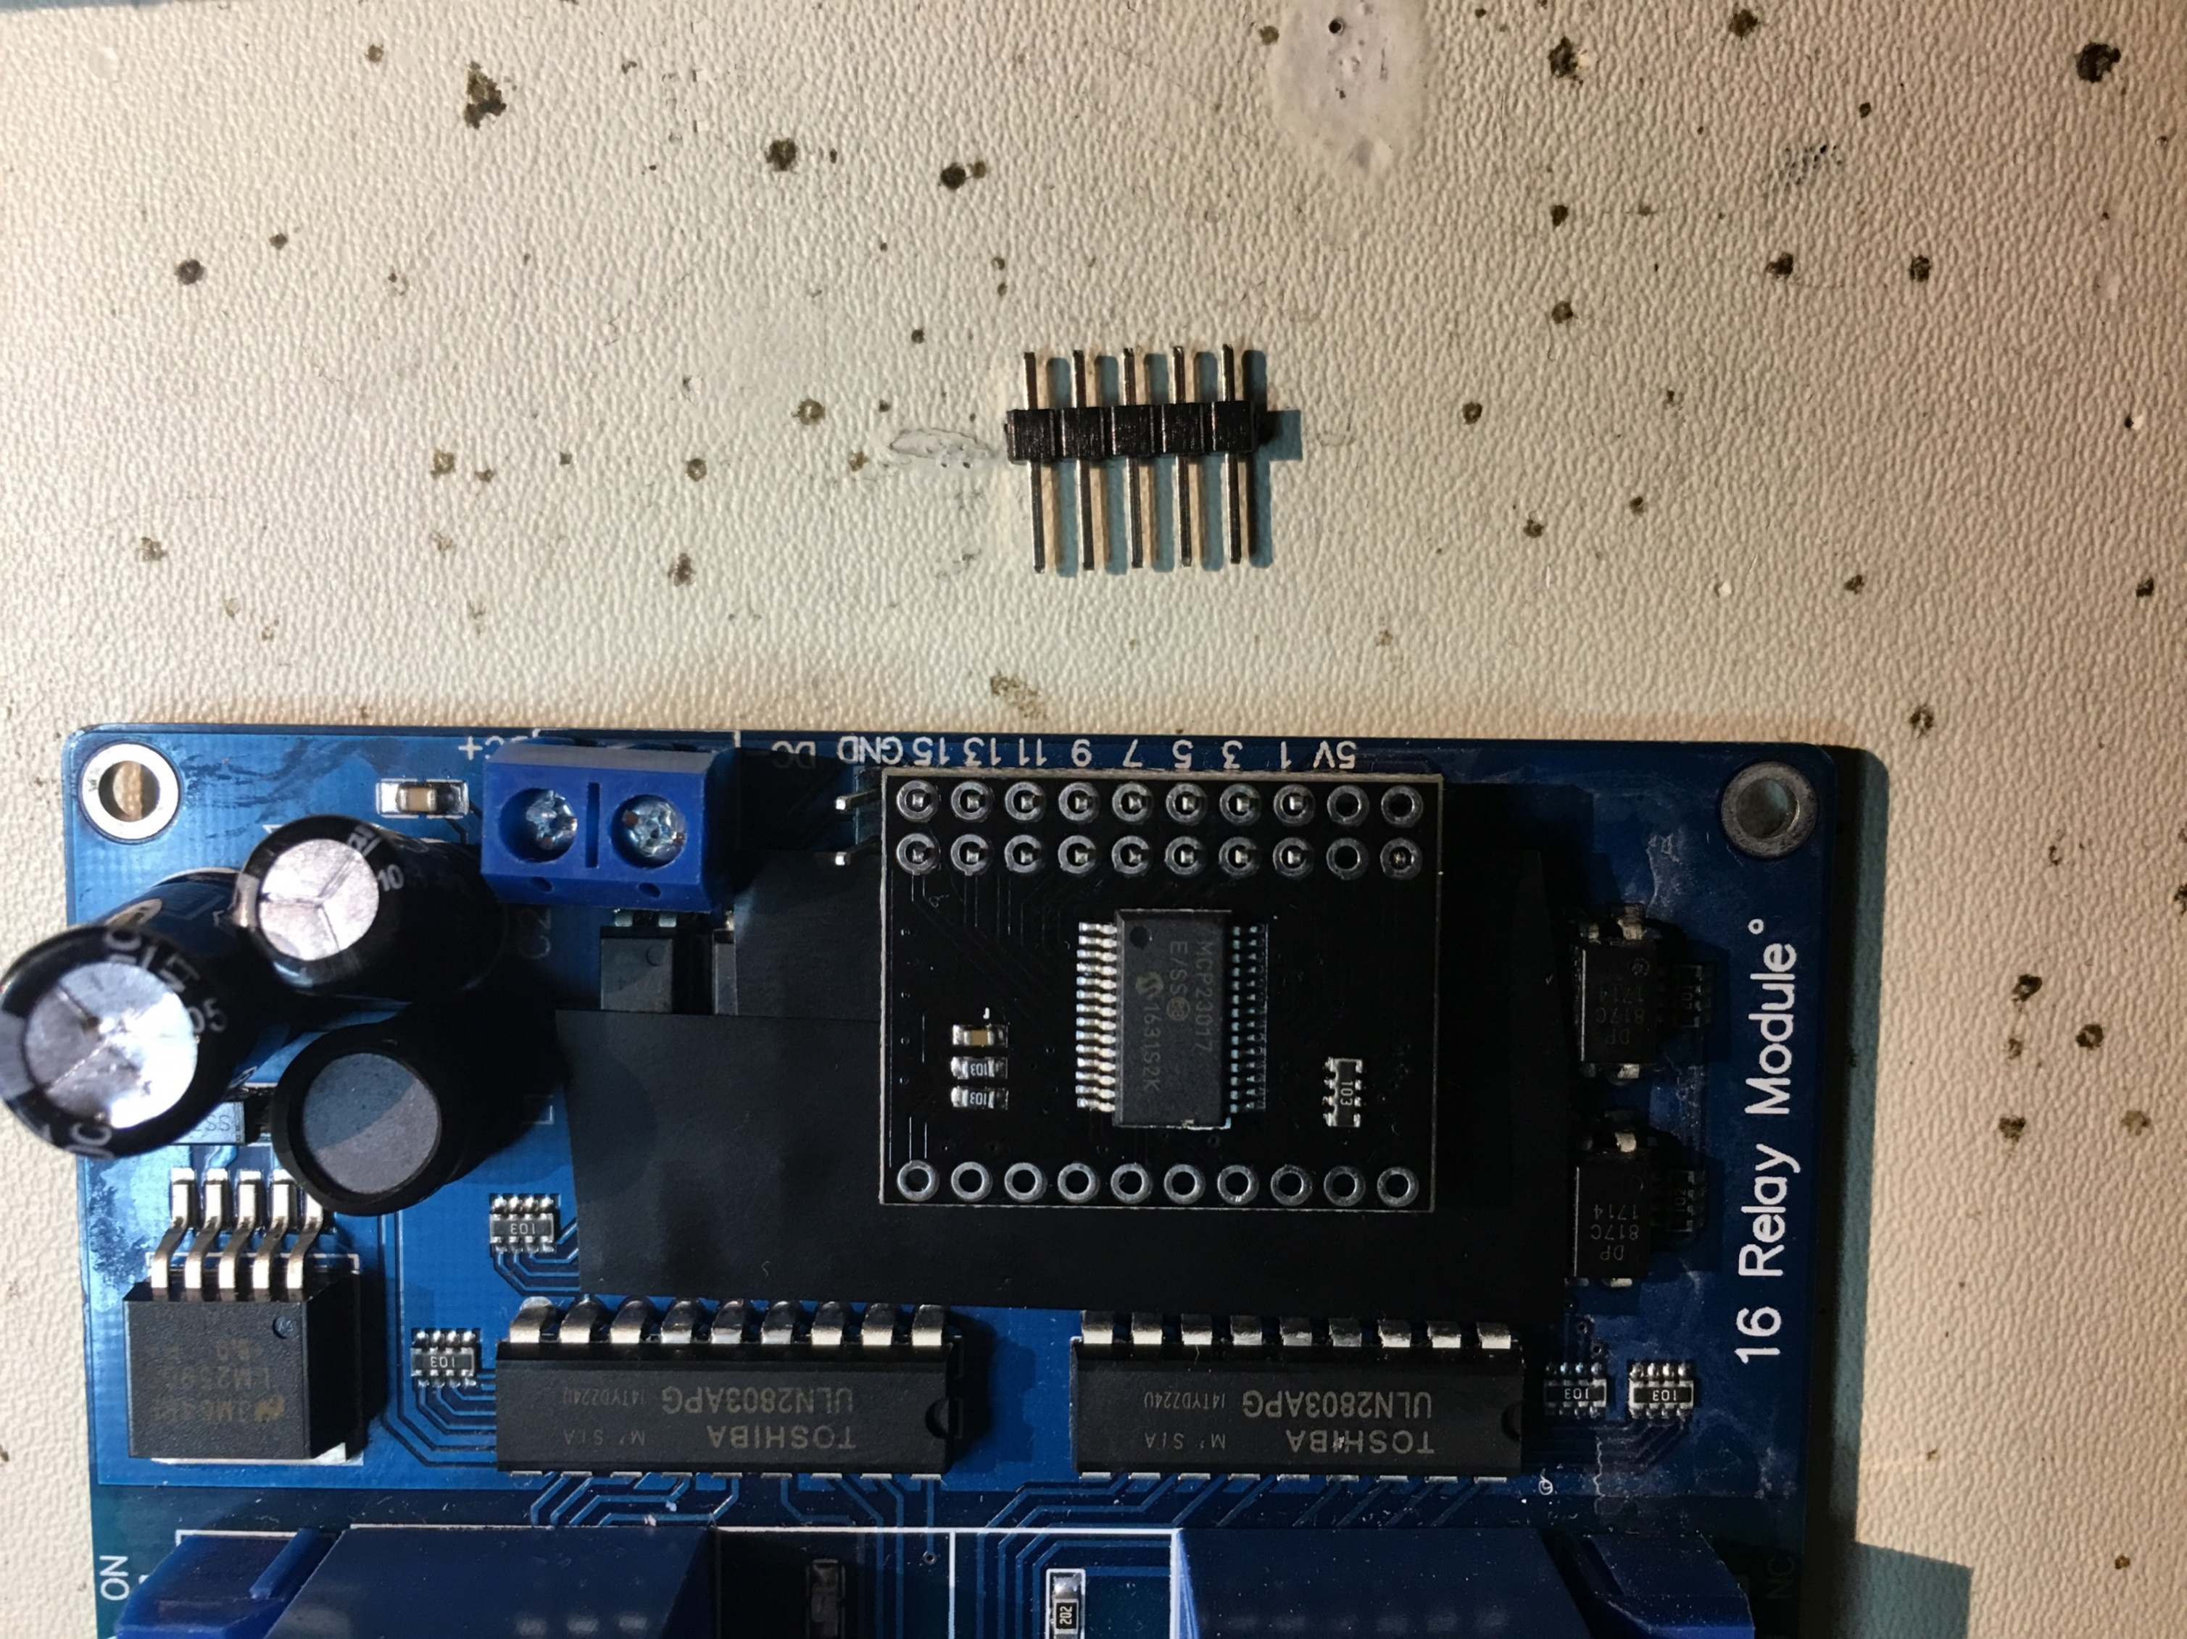
Wiring up your Relaysboard… 4
Connect the MCP-Board:
-1- the „S“ bent pin is visible. To be soldered later.
-2- complete bent pin is not visible
Pin position ¾ is not connected.
On the right: Free GND-Pins (see: later))
Important: Do not solder anything yet! Just see if it fits already. Maybe re-bent.
1
2

Slide 29
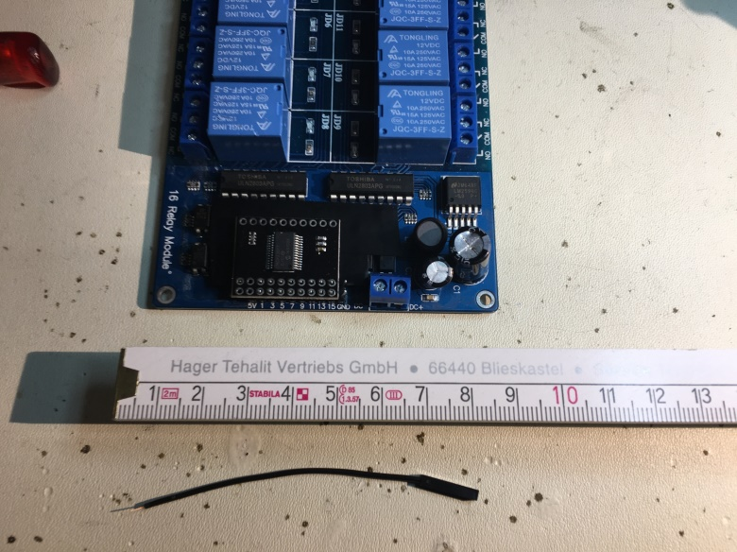
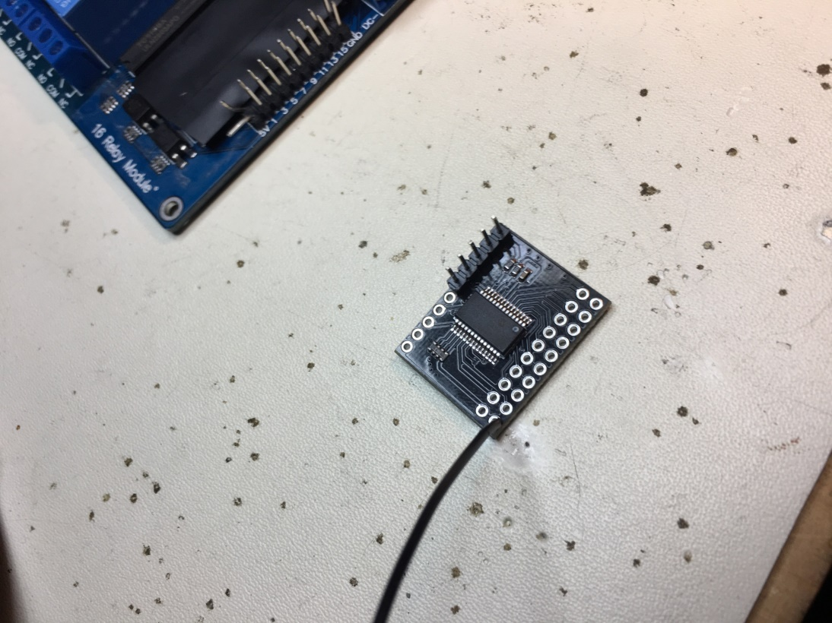
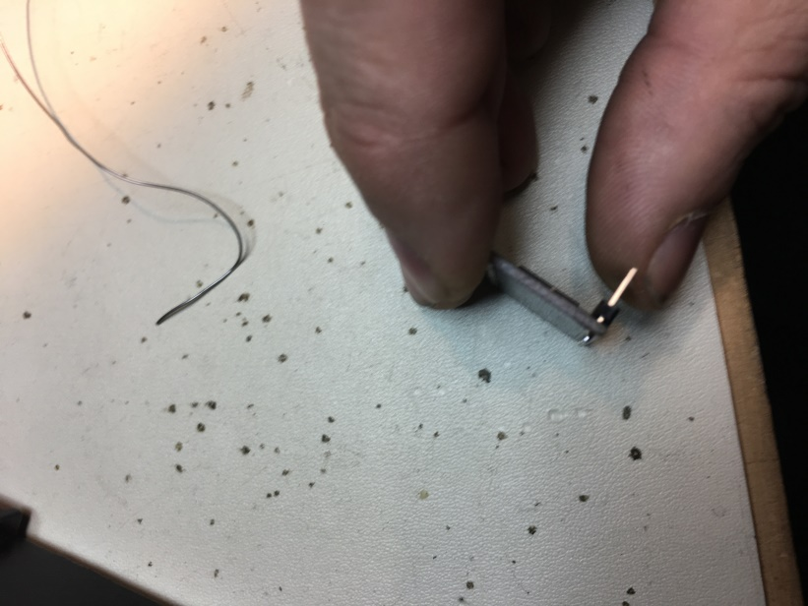
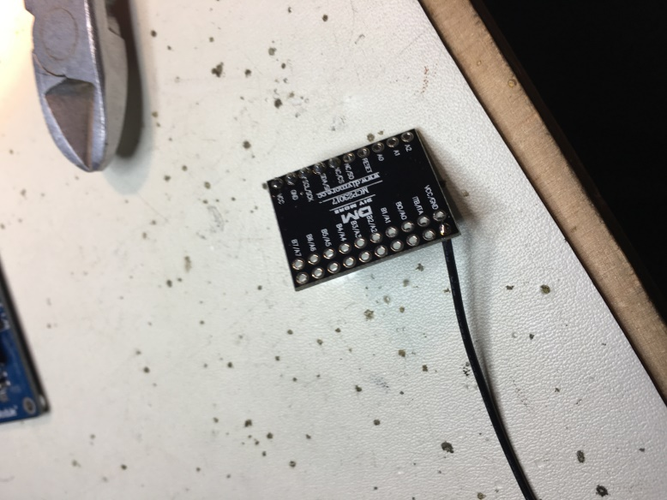
Connecting the MCP-23017 board
Use 4 Pin-Header and 1x GND-Wire and solder them:
x

Slide 30
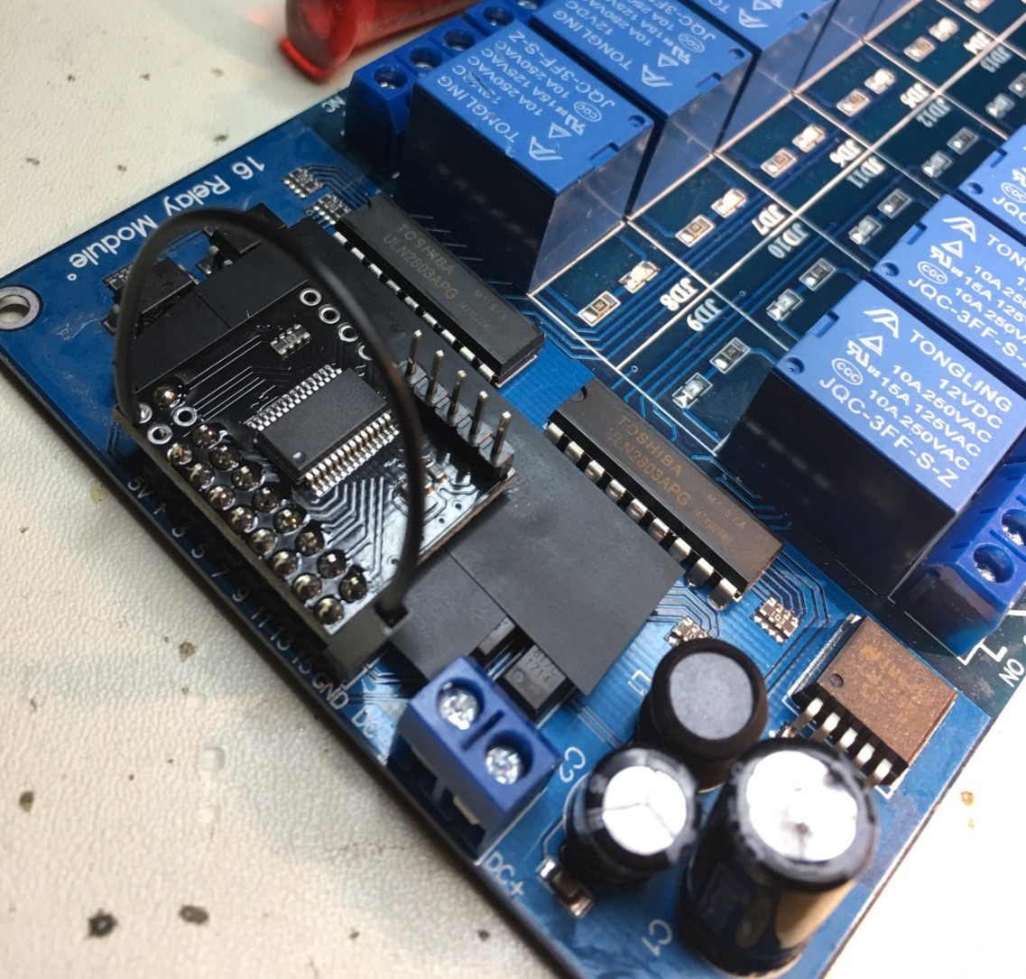
Soldering MCP-23017 board onto your RelayBoard
Use tape
Place your MCP-Board correct
Solder MCP-PCB with your Relayboard
Connect GND-Wire with your RelayBoard

Slide 31
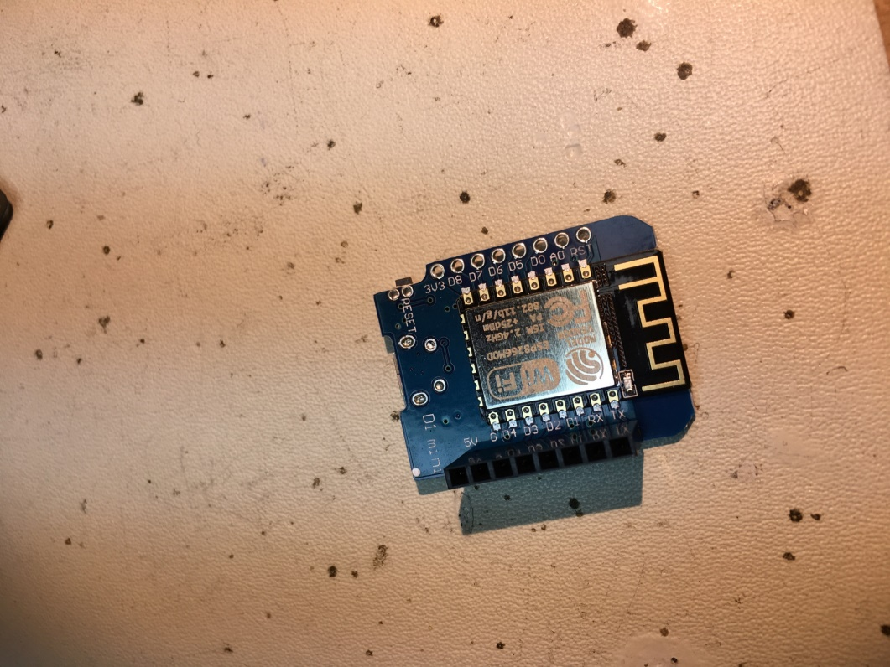
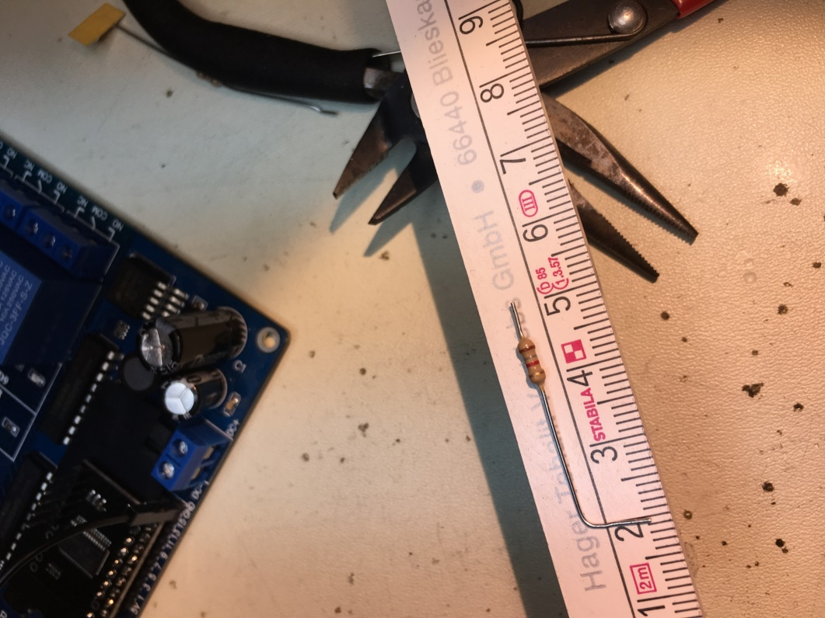
Preparing your ESP-12F… 1
Solder Female Header & prepare your 1k8/2k2 resistors:

Slide 32
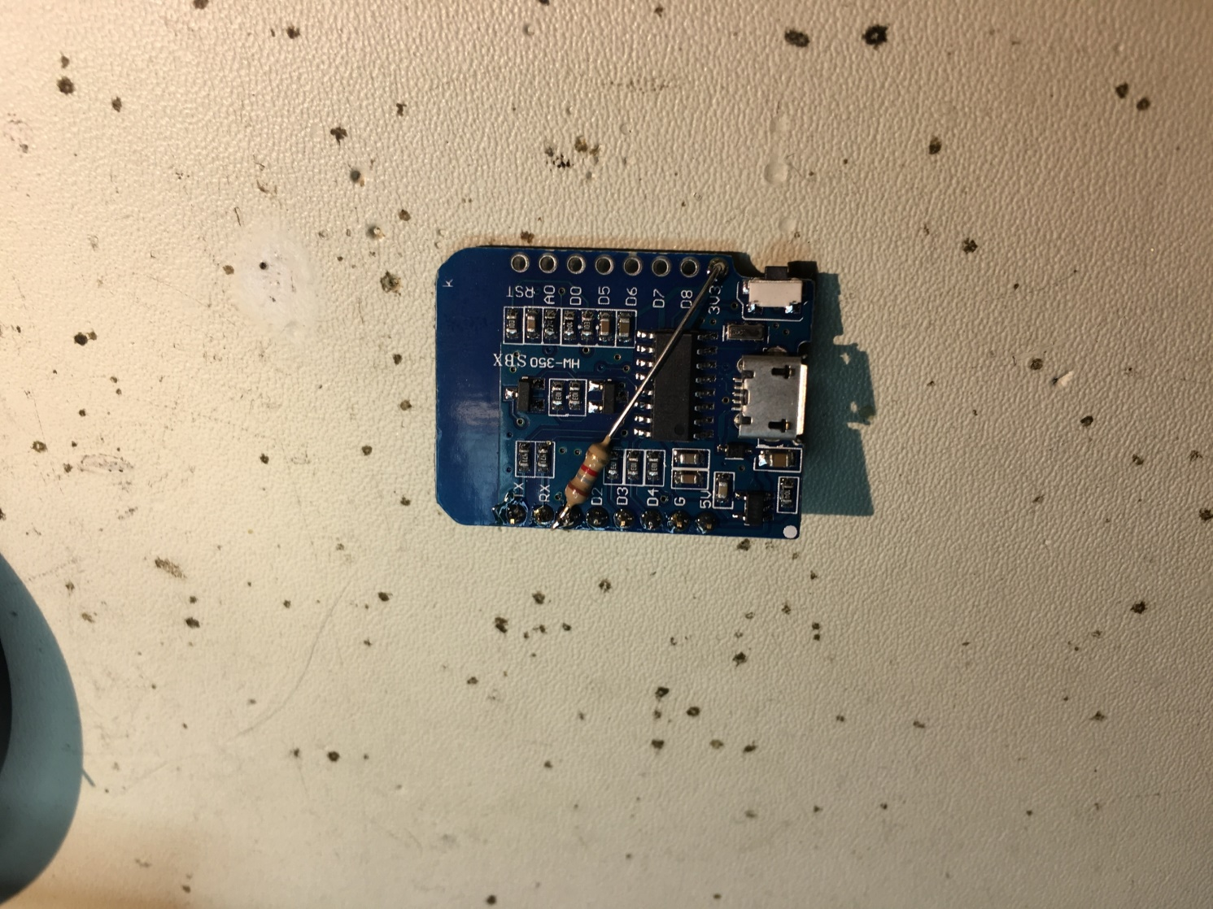
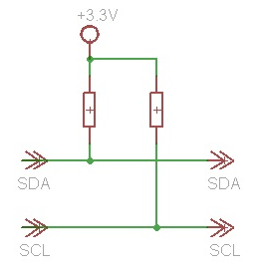
Preparing your ESP-12F… 2
Solder your first 1k8/2k2 resistor. Pin D1 ➔ 3V3!
Be careful :P…

Slide 33
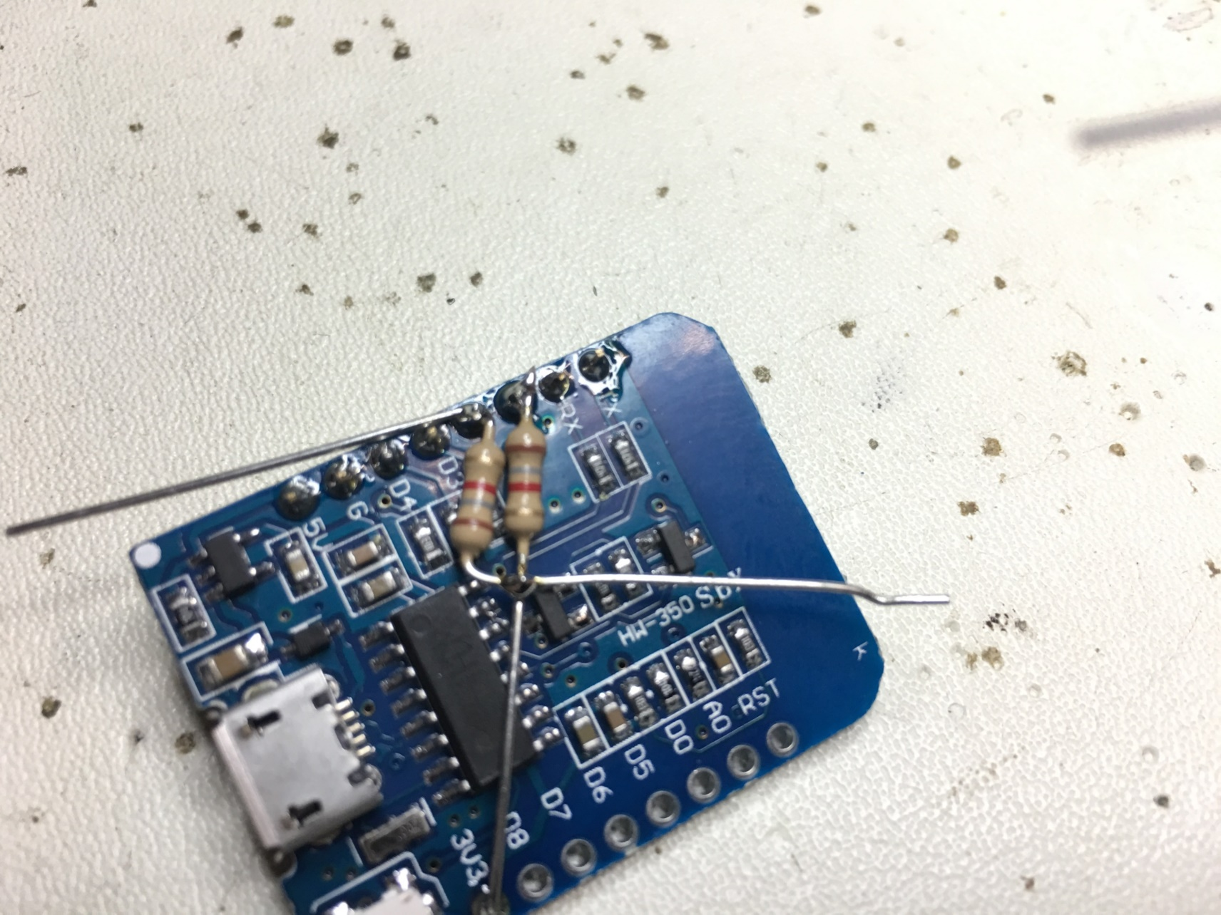
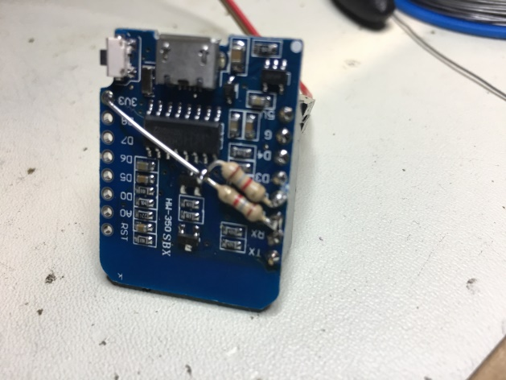
Preparing your ESP-12F… 3
Bent your second resistor 1k8/2k2 into an „S“ and solder it.
D2 ➔ 3V3
Cut.
Be careful :P…

Slide 34
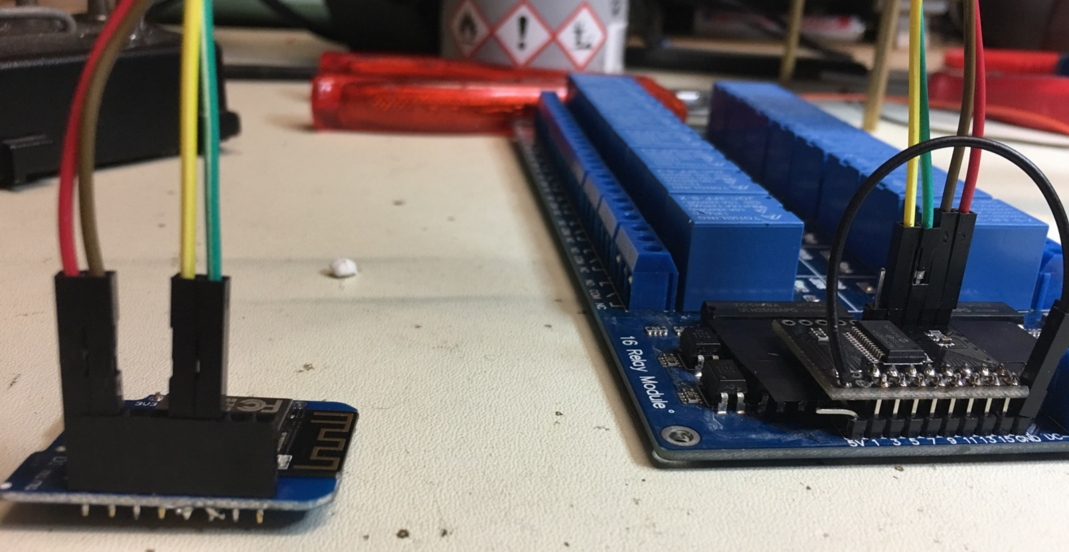
Put it all together…
Wemos from left to right (example): 5V|GND|empty|empty|yellow|green
MCP from the left: Yellow|Green|GND|5V
SCHWARZ to GND (Relayboard)
Your wire colors may be different!

Slide 35
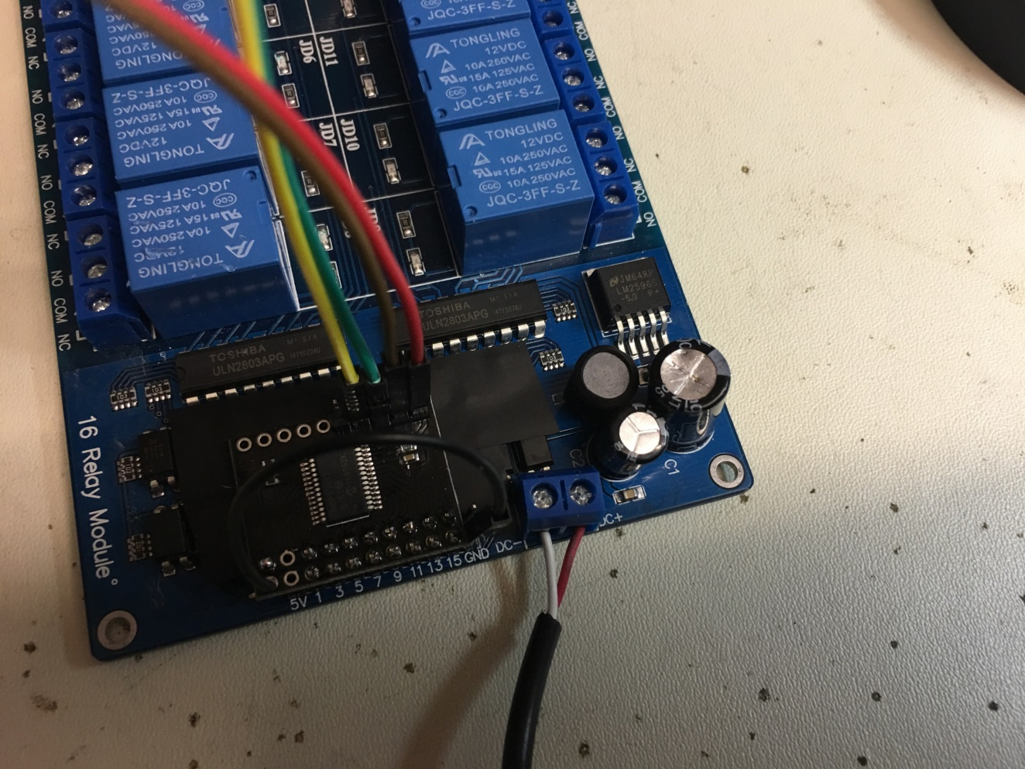
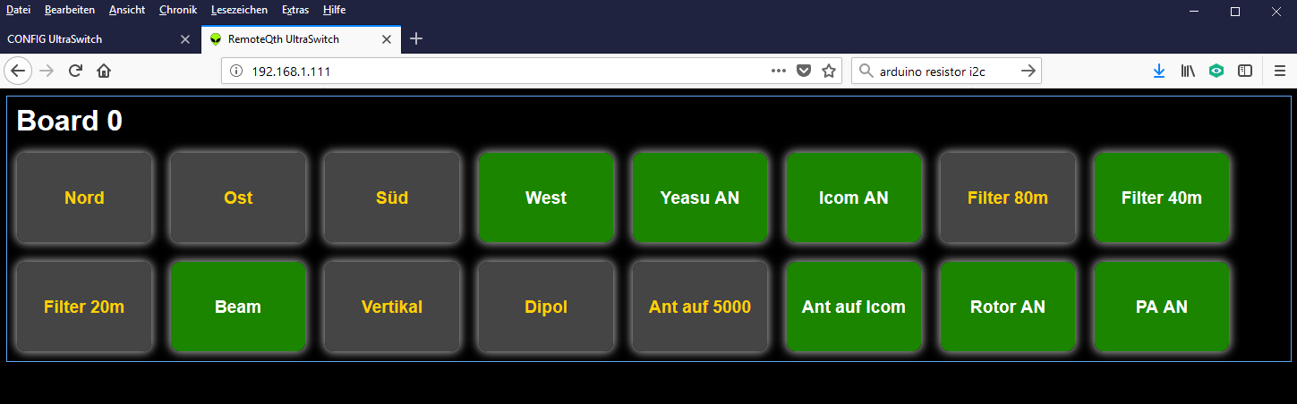
Finally…
Connect your power supply 12V
Power on
Start your browser
Be happy! ☺

Slide 36
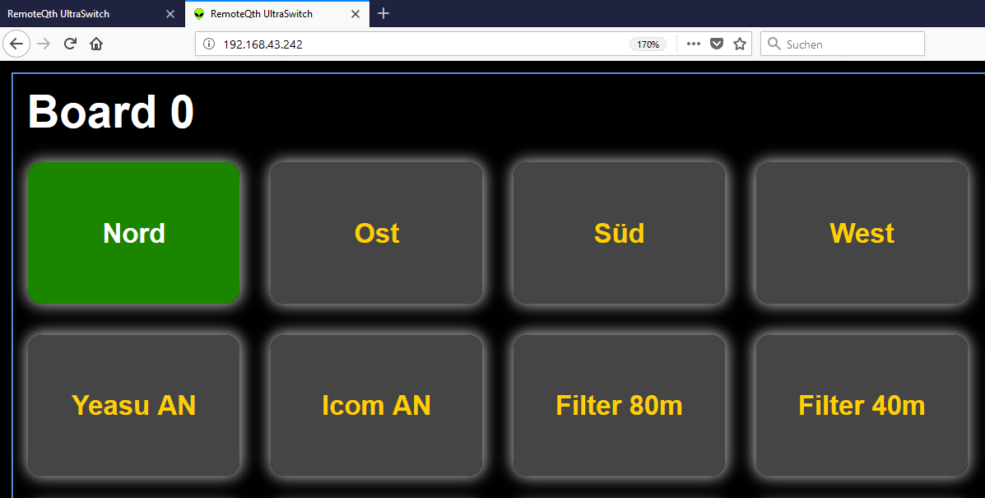
Back to the beginning... Use Case 1
Call your ultraswitch by its ip
The Ultraswitch returns his index.html
Labels, groups, … are loaded from h.mmmedia-online.de
=> No customizing necessary if this fulfills your needs..

Slide 37
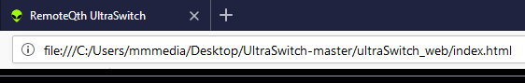
Back to the beginning... UseCase 2... 1
The Ultraswitch is called using your local stored (eg. desktop) index.html
E.g file:///C:/Users/mmmedia/Desktop/UltraSwitch-master/ultraSwitch_web/index.html
All files can be local: Customize!

Slide 38
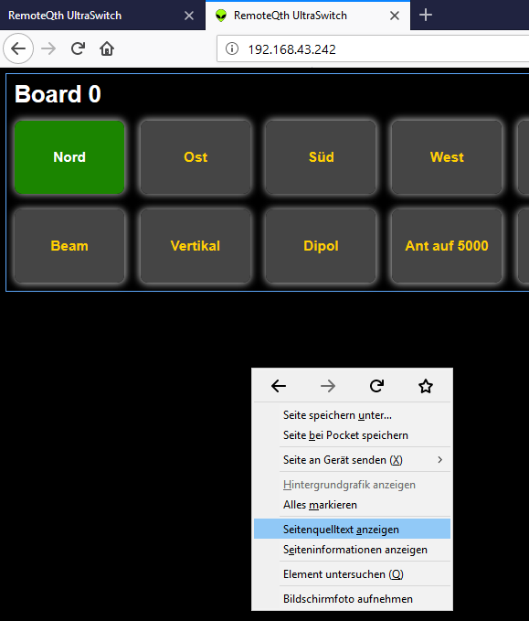
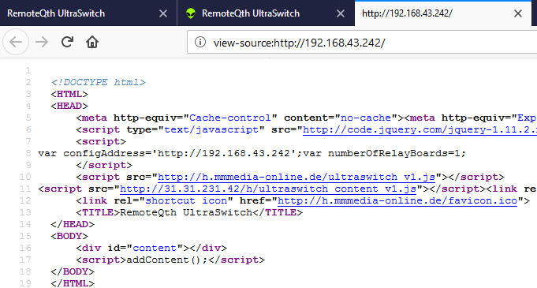
Back to the beginning... Creating your own index.html... 1
Call Ultraswitch by IP e.g. 192.168.43.242
Right-Click somewhere to the black backround of the webpage and say „show source code“
Copy the complete text into your clipboard

Slide 39
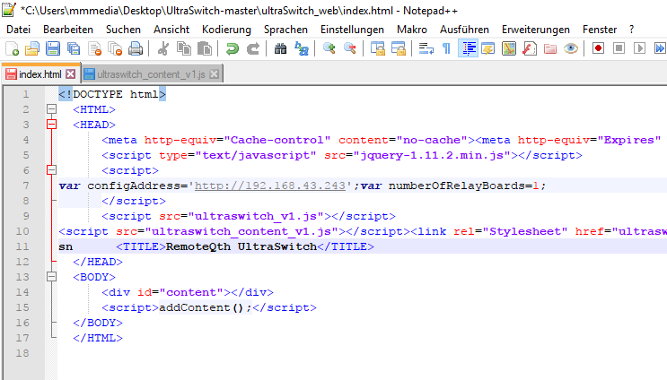
Back to the beginning... Creating your own index.html... 2
Open th index.hml from your ultraswitch_web folder with an Editor .
Remove all the code
Past the text from your clipboard
Open the new index.html. All should be visible like before – if not look into CORS (see later)

Slide 40
UseCase 2... All local!
If all needed files are all in the same local directory like your index.html, than you can change the file paths like this: e.g. change src=„http://h.mmmedia-online.de/ultraswitch_v1.js“ to this src=„ultraswitch_v1.js“
If all http://<url>/<filename> changed into <filename>, all is working without the internet
Problem: jquery must be local, too!
Ask someone near you, who knows how to do web pages for help.

Slide 41
Customizing => Labels, Groups, RelaysPerBoard
Customizing your ultraswitch_content_v1.js:
Labels => textboard0 = Labels for the 1. Board etc… var textboard0 = ["Nord","Ost","Süd","West","Yeasu AN","Icom AN","Filter 80m","Filter 40m","Filter 20m","Beam","Vertikal","Dipol","Ant auf 5000","Ant auf Icom","Rotor AN","PA AN"]; ➔ Change it, but keep it short!!
Groups => board0Group = Grouping pins definition for your 1. Board… var board0Group = [[0,1,2,3],[6,7,8],[9,10,11],[12,13]]; What does it mean: On Board 1 with the id 0 are 4 groups defined. First group: button 0,1,2,3 is connected together in a way “there can be only one”-
numberOfRelaysPerBoard = How many Relays per Board (1., 2., 3.,…) var numberOfRelaysPerBoard = [14,16,16,16,16,16,16,16,16,16,16,16,16,16,16,16]; What does it mean: Your first board controls 14 Relays, 2nd 16, ….

Slide 42
UseCase 3... Using your own Webspace /webserver
Your own Webserver (e.g. RaspiPI):
Use Config.html to point the content IP-Adresse to your OWN WEBSERVER.
The URL to ultraswitch_content_v1.js and ultraswitch_v1.css is generated by naming convention: http://<own_ip>/h/<filename>!
HowTo:
Create a subdirectory named „h“ in your webserver/webspace root.
Copy your own Ultraswitch_content_v1.js und ultraswitch_v1.css into this folder.
Call Ultraswitch just with its IP! Ist not needed to call the Ultraswitch by your local index.html
Using a Raspberry PI , use his IP-Adresse.

Slide 43
Umschiffen von Engstellen… Wenns mal hängt!
Aufgrund seines „Alters“ ist die Ethernet-Schnittstelle mit den Optimierungen heutiger Web-Browser überfordert.
Die Ethernet-Lib kann nur 4 Verbindungen gleichzeitig handeln, aber moderne Browser öffnen Duzende.
Irgendwann komm der Mikrocontroller ins straucheln und hängt sich auf.
Workaround: MicroFox (siehe Verzeichnis „Software“) – eine angepasste Version des Firefox, bei den die Max-Connection-Zahl auf 2 beschränkt wurde. Zwar surft es sich damit nicht mehr gut im Netz, aber der Ultraswitch kann prima damit gesteuert werden. Sollte es also zu Problemen kommen, bitte nur den MicroFox als Browser verwenden. (Auch mobile Firefox können angepasst werden – see about:config)

Slide 44
Aufbau und Funktionsweise des Sourcecodes
Main-Sketch auf dem ESP12F für Hardwarekontrolle, JSON, WebServer: UltraSwitch.ino
Benutzte Bibliotheken: Adafruit-MCP23017 ➔ I2C-Kontrolle MCP23017 ArduinoJson ➔ JSON Format für das Webserver-Response WiFiManager ➔ Einfach Konfiguration des Webservers
Ultraswitch_content_v1.js ➔ Konfiguration der Labes, Gruppen, etc. (Beschriftungen) Ultraswitch_v1.js ➔ Schaltlogik und Steuerung der UI-Element Ultraswitch_v1.css ➔ UI Look&Feel, Buttongröße, Farben, etc. (Buttons)
Setup_esp.html ➔ Vorkonfiguration des ESP12F Access-Points Config.html ➔ Konfiguration der IP- und Servereigenschaften index.html ➔ Lokale ESP12F Anwendung (Einstiegspunkt)

Slide 45
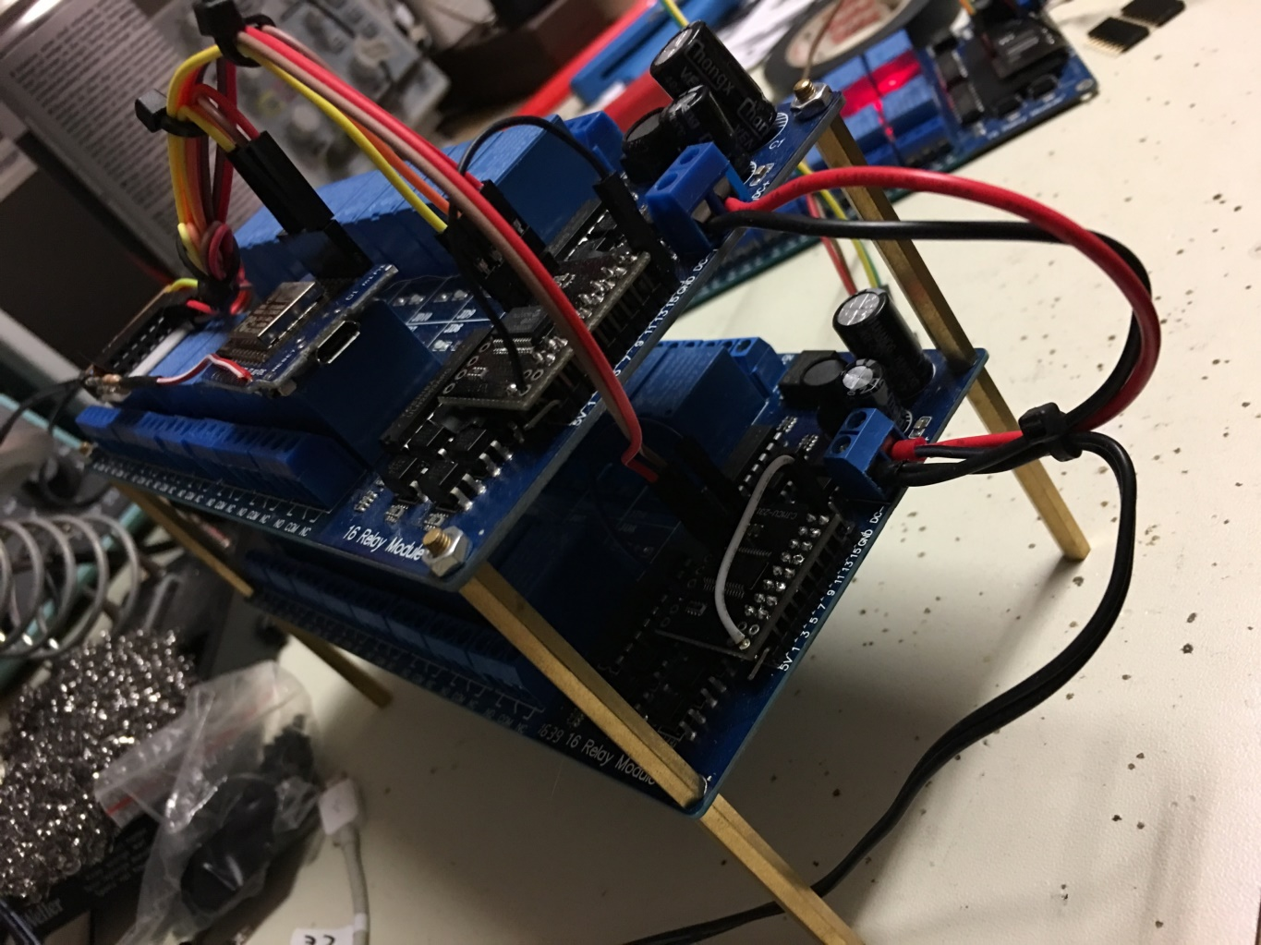
Weitere Module…
Weitere RelayBoards wie beschrieben zusammenbauen
I2C-Adresse vergeben! (nächste Folie)
Nur Gelb|Grün mit Gelb|Grün verbinden (Parallel-Bus)
Stromversorgung einfügen
Config.html ➔ Board-Anzahl
Fertig!

Slide 46
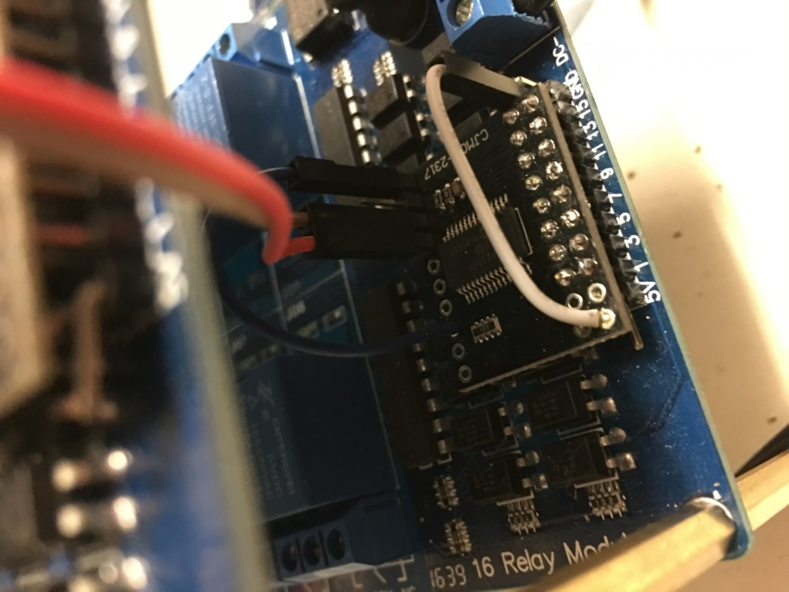
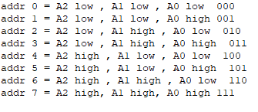
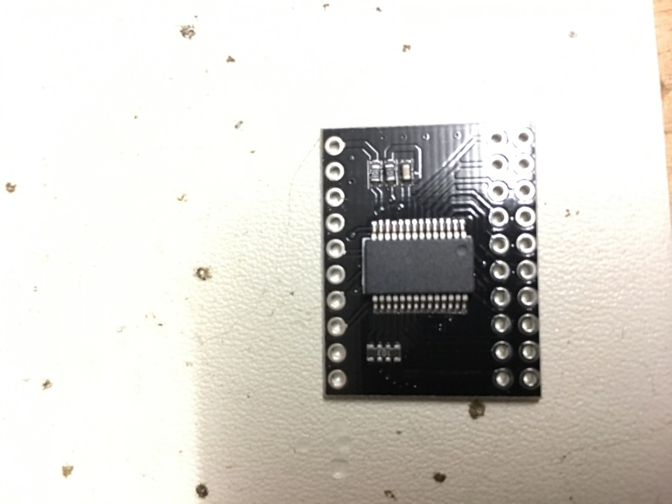
Weitere Module… I2C Adressierung => Bis zu 8 Devices!
Die Verbindung mit 5V (HIGH) muss genau in der Reihenfolge durchgeführt werden: 0 => 1. Board, 1 => 2. Board, 2=> 3. Board, …!!!
Hinweis: Nicht verbunden => LOW
A0
A1
A2
5V
GND
SCL
SCA

Slide 47
Viel Platz für eigene Ideen…
Mehrere Ultraswitch-Cluster
Nutzung des ADC-IN für Messungen (Temperatur, etc.)
Verwendung als Antennenschalter (Wichtig: Abschirmung, Gehäuse…)
Zeitsteuerung von Pins (siehe mega-webswitch)
Integration in N1MM (M. Hammelmann, DK5AX), Linuxanwendung
Remote-Schalter für Remote Station (VPN wird empfohlen)
Integration mit einem Raspberry PI als Server (UDP, Broadcast)
…

Slide 48
THE END - Danke für Eure Aufmerksamkeit - - Email: dm5xx@gmx.de -

